Slide 1


DWP Employer & Partnerships Stakeholder Toolkit
This toolkit has been designed for you to select appropriate assets and share with your networks
and partners to support local and national DWP recruitment. Individual asset files are designed to
be used on stakeholders' own communication channels.
What’s included:
Introduction email for external stakeholders.
Social media assets, quotes and short videos from DWP colleagues talking about the benefits of their jobs,
including supporting copy for Facebook and X in English and Welsh.
Selected print ready A4 posters and A5 leaflets.
Video (MP4 files) can be shared through local DWP social media channels using this SharePoint folder

Slide 2
DWP advertises a wide range of job roles throughout the year, across different geographical areas and times.
A number of promotional products have been developed, to help publicise different job roles in DWP. You can share appropriate assets with your customers, partners and networks when your local area is recruiting.
Click below for more details of the products* available for each area and how they can be used.
    Dispute Resolution Service
    Work & Heath Service
    Counter Fraud, Compliance & Debt
    Retirement Services Division
    Jobcentre Plus Work Coach
    Universal Credit Review Agents
    Disability Services
    Child Maintenance Service
How to use the Workforce Recruitment campaign promotional products
Posters and leaflets were produced to support large scale Work Coach and UC Review Agent recruitment campaigns.
Please note promotional products for the other DWP business areas in this toolkit are digital assets only.

Slide 3


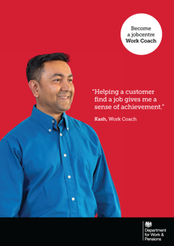


DWP Work Coach role helps individuals and their families towards financial independence through work and enabling them to claim the support they need as they progress.
Download social media video and quotepics posts for Facebook and X
Print ready A4 posters
Post copy for videos
If you want to start your rewarding career with flexible hours and on the job training, apply for DWP jobs today.
For more information -
Executive Officer Recruitment | DWP jobs
Post copy for Quotepics
Your local jobcentre is hiring!
Make a difference, become a jobcentre Work Coach.​ Find an opportunity near you and apply today.
For more information -
Executive Officer Recruitment | DWP jobs
Work Coach (WC) posters were developed to support large scale recruitment campaigns. These can be used as necessary for future WC recruitment.
Use the links in red above to download the Work Coach promotional products.

Slide 4
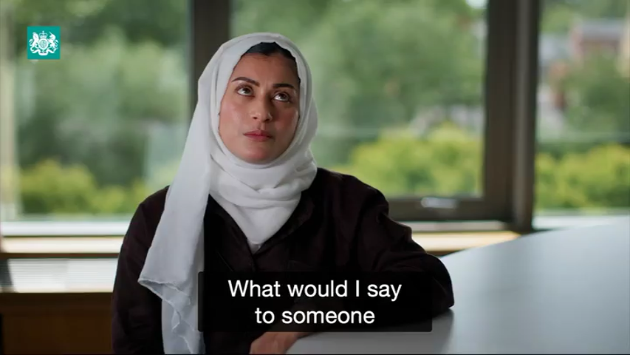





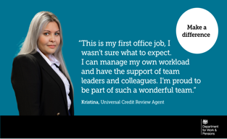
Universal Credit Review Agents ensure claimants receive the payments they are entitled to. Their role is to coach and support claimants to enable them to keep their Universal Credit claims up to date.
Download social media video and quotepics posts for Facebook and X
Print ready A4 posters & A5 leaflets
Post copy for videos
If you want to start your rewarding career with flexible hours and on the job training, apply for DWP jobs today.
For more information -
Executive Officer Recruitment | DWP jobs
Universal Credit Review Agent (UCRA) posters were developed to support large scale recruitment campaigns. These can be used as necessary for future UCRA recruitment.
Post copy for Quotepics
We’re hiring in your area. ​
Apply today for a rewarding career with flexible hours and a range of employee benefits.
For more information -
Executive Officer Recruitment | DWP jobs
Use the links in red above to download the Universal Credit Review Agent promotional products.

Slide 5

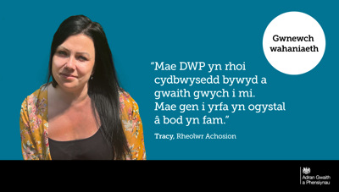
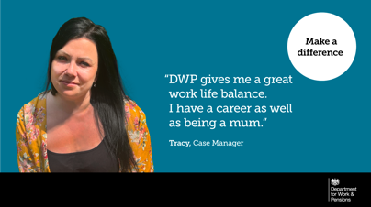
Disability Services (DS) work with customers and their representatives over the telephone to resolve queries around disability benefit awards and to explain decisions.
Tracy talks about working in DS as a Case Manager and promotes some of the benefits of working for DWP.
Download social media video and quotepics posts for Facebook and X
Post copy for Videos and Quotepics
If you want to start your rewarding career with flexible hours and on the job training, apply for DWP jobs today.
For more information -
Executive Officer Recruitment | DWP jobs
Use the links in red above to download the DS Case Manager promotional products.

Slide 6

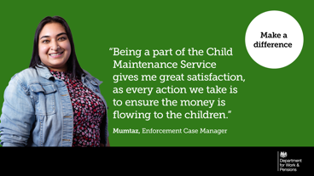
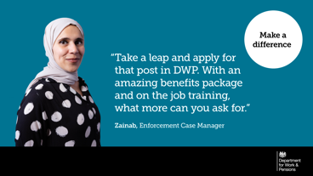
Child Maintenance Service (CMS) work with customers, employers and colleagues through a combination of digital and telephone contact on a daily basis. Enforcement Case Managers can make a huge difference to help families through some difficult and challenging times in their lives.
Mumtaz talks about working in CMS and promotes some of the benefits of working for DWP.
Download social media video and quotepics posts for Facebook and X
Post copy for Videos and Quotepics
If you want to start your rewarding career with flexible hours and on the job training, apply for DWP jobs today.
For more information -
Executive Officer Recruitment | DWP jobs
Quotepic x2
Use the links in red above to download the CMS promotional products.

Slide 7
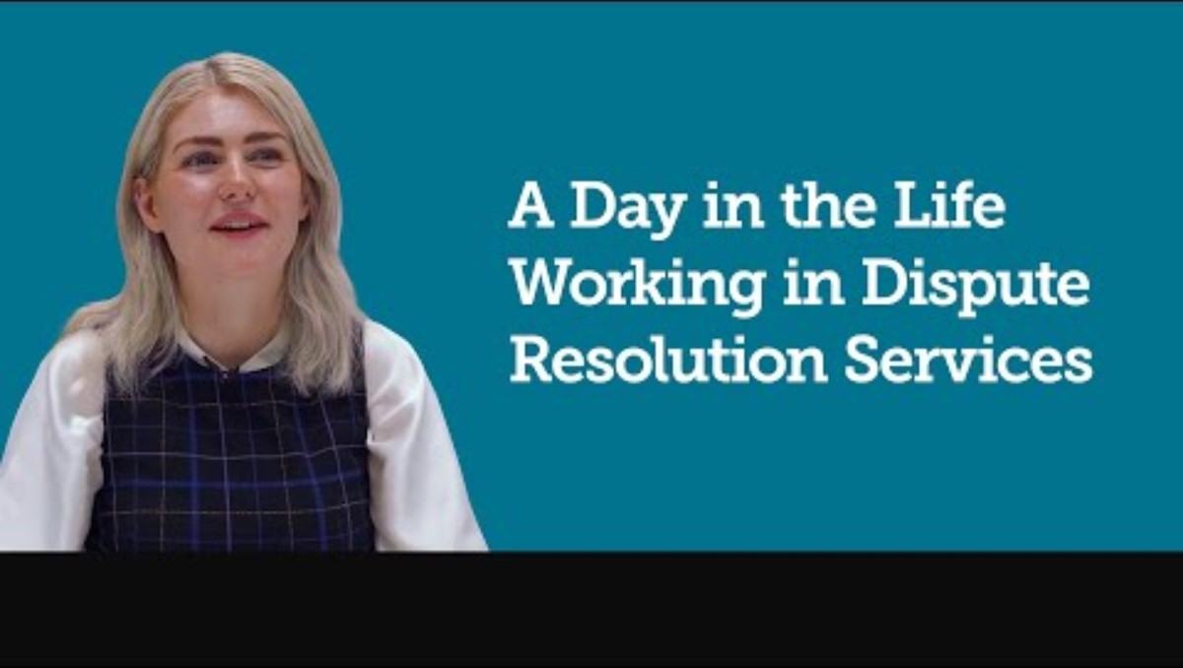
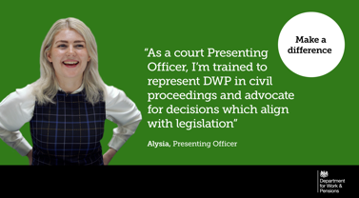
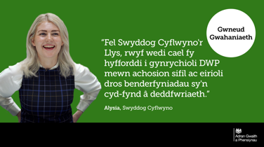
Dispute Resolution Services (DRS) if a DWP customer disagrees with a decision about benefits, tax credits or child maintenance they can ask for the decision to be looked at again (mandatory reconsideration) or submit an appeal against a benefit decision.
Alysia talks about working in DRS as a Presenting Officer and promotes some of the benefits of working for DWP.
Download social media video and quotepics posts for Facebook and X
Post copy for Videos and Quotepics
If you want to start your rewarding career with flexible hours and on the job training, apply for DWP jobs today.
For more information -
Executive Officer Recruitment | DWP jobs
Use the links in red above to download the DRS promotional products.

Slide 8

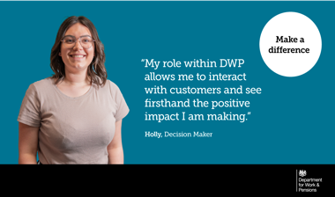
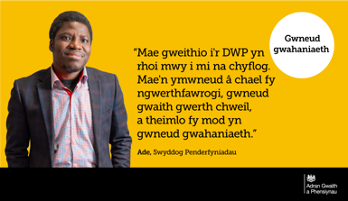
Work & Health Services (W&HS) Decision Maker work with DWP customers through a combination of digital and telephony to make decisions on each case.
Melody talks about working in W&HS as a Decision Maker and promotes some of the benefits of working for DWP.
Download social media video and quotepics posts for Facebook and X
Post copy for Videos and Quotepics
If you want to start your rewarding career with flexible hours and on the job training, apply for DWP jobs today.
For more information -
Executive Officer Recruitment | DWP jobs
Use the links in red above to download the Decision Maker promotional products.

Slide 9


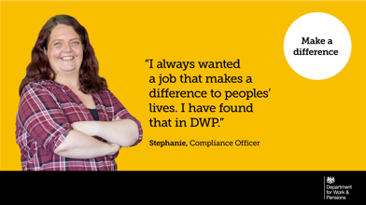
Counter Fraud, Compliance and Debt (CFCD) work with customers over the phone or conducting face-to-face interviews to review claims, checking that declarations and changes have been reported at the right time and taking appropriate corrective action if errors are found.
Stephanie talks about working in CFCD as a Compliance Officer and promotes some of the benefits of working for DWP.
Download social media video and quotepics posts for Facebook and X
Post copy for Videos and Quotepics
If you want to start your rewarding career with flexible hours and on the job training, apply for DWP jobs today.
For more information -
Executive Officer Recruitment | DWP jobs
Use the links in red above to download the Compliance Officer promotional products.

Slide 10


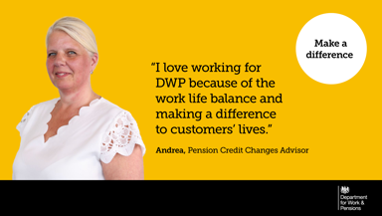
Retirement Services Division (RSD) work with customers over the telephone to administer their State Pension, Pension Credit, delivering bereavement services and other benefits such as Attendance Allowance and Carer’s Allowance.
David talks about working in RSD as a Pension Credit Changes Team Leader and promotes some of the benefits of working for DWP.
Download social media video and quotepics posts for Facebook and X
Post copy for Videos and Quotepics
If you want to start your rewarding career with flexible hours and on the job training, apply for DWP jobs today.
For more information -
Executive Officer Recruitment | DWP jobs
Use the links in red above to download the RSD promotional products.

Slide 11
How to use the Workforce Recruitment campaign promotional products
Each recruitment campaign asset (product) has a unique file name to manage the maintenance of the asset and identify which is the most appropriate to use.
Download the appropriate product files from the links in the toolkit, you will see the files available to use on digital platforms, such as Facebook and X.
To help identify which file to use, the following naming convention has been created. For example:
Jobcentre work coach vacancies – the file name will be- WC_name of person featured_ type of product_file name .
Note: Welsh Assets are identified by adding ‘W’ after the product. Welsh video subtitles can be downloaded here.
      WC_CARO_VID_ means this asset features Jobcentre work coach Caroline talking about what it’s like being a work coach in a video.
      WC_CARO_QP_ is Jobcentre work coach Caroline’s quote in a social media quotepic for use on Facebook and X.
      WC_CARO_A4_ is Jobcentre work coach Caroline featured on an A4 poster.
      The file naming convention is replicated for all DWP business areas in the toolkit.
Universal Credit Review Agent - UCRA_JUN_VID_
Disability Services – DS_TRAC_QP
Child Maintenance Services – C MS_ZAIN_QP
Dispute Resolution – DRS_ALYS_QP
Which product to use? - DWP encourages a diverse range of people to apply for jobs, so you may want to choose a colleague featured that represent a cohort in your local labour market that is underrepresented.
Attach appropriate SM assets and supporting copy to your email asking your trusted networks to publicise the vacancies through their own networks.
Remind your partners not to alter the embedded links in any way please.
Work & Health Service – DM_GERA_QP
Counter Fraud, Compliance & Debt – CFCD_STEP_QP
Retirement Services Division- RSD_ANDR_QP

Slide 12
Additional information
Please note all these products have been developed to support the DWP Recruitment Brand | DWP Intranet
Please take a look at the EO recruitment microsite for information on current vacancies.
The centralised recruitment team have an evaluation report demonstrating the success of
a high volume recruitment exercise including a LinkedIn trial. You can request this report by emailing eo.resourcing@DWP.GOV.UK , with a subject header of 'Attraction Outcomes'.

